Slide 1

WHY HAVE I NOT HEARD ABOUT
?
$
$
$
$
$
NO
NO
NO
PAID MARKETING
INFLUENCER SHILLS
PAID EXCHANGE LISTINGS
NO
NO
CORPORATE PR
VENTURE CAPITALISTS
NO
NO
NO
ICO
PREMINE
COMPANY
BEHIND IT
Epic Cash is anonymous P2P electronic cash on a blockchain that is open, public, permissionless, borderless and neutral. As an ”enhanced censorship resistance” implementation of the familiar Bitcoin monetary standard, users enjoy trustless operation, hold direct custody of coins, and transact directly with one another through the blockchain. Epic is secured Polyphasic Proof-of-Work and provides quantum resistance by design.
EC 210403 - Why have I not heard about Epic Cash?_v02

Slide 2
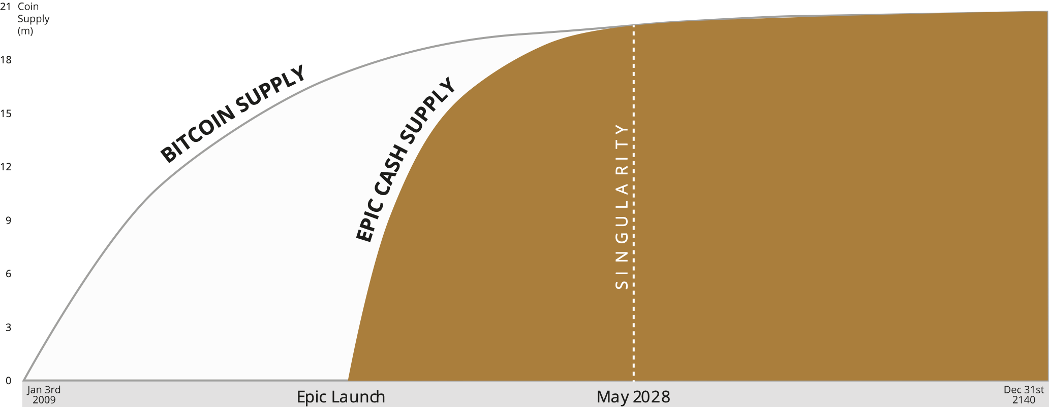
TECHNICAL SECURITY
CPU
GPU
ASIC
3x
proof-of-work
Multi–algo Mining
Quantum protection + future-proofing protection against compromised algorithms
ECONOMIC SECURITY
21M MAXIMUM SUPPLY DEC 2140
T1 11/21
T2 7/23
T3 9/25
T4 6/28
HALVING DATES
100% backwards compatible with BTC.
4 halvings in 8 years – most aggressive of any crypto asset.
Consider this: in 7 years there will only be 210 coins per day created for 8 billion people. Can you afford not to own one?
REGULATORY SECURITY
Howey Compliant – No ICO, No pre-mine, no investors, no control. Respected US attorney opinion letter: “Epic Cash is not a security”
GOVERNANCE SECURITY
Transparent open community, all decisions made out in the open. ECR token with proven governance modules from Compound. https://labs.epic.tech
SOCIAL SECURITY
EDXL LLC, through its regional operating partners supports markets by providing “buyer of last resort” immediate spot liquidity to hundreds of digital asset revenues worldwide.
EDXC dedicates a portion* of cash flows to fund a daily buyback and burn initiative of the EDXC token.
Fair & accessible – anyone can mine. BTC is almost 90% already emitted. EPIC is only 50% emitted. Mining is open to anyone, meaning you too can get your share. Low barriers to entry promise “pitchfork and torch” protection

